Slide 1
Regression Analysis for White Wine
Elizabeth Do
Austin Harper

Slide 2
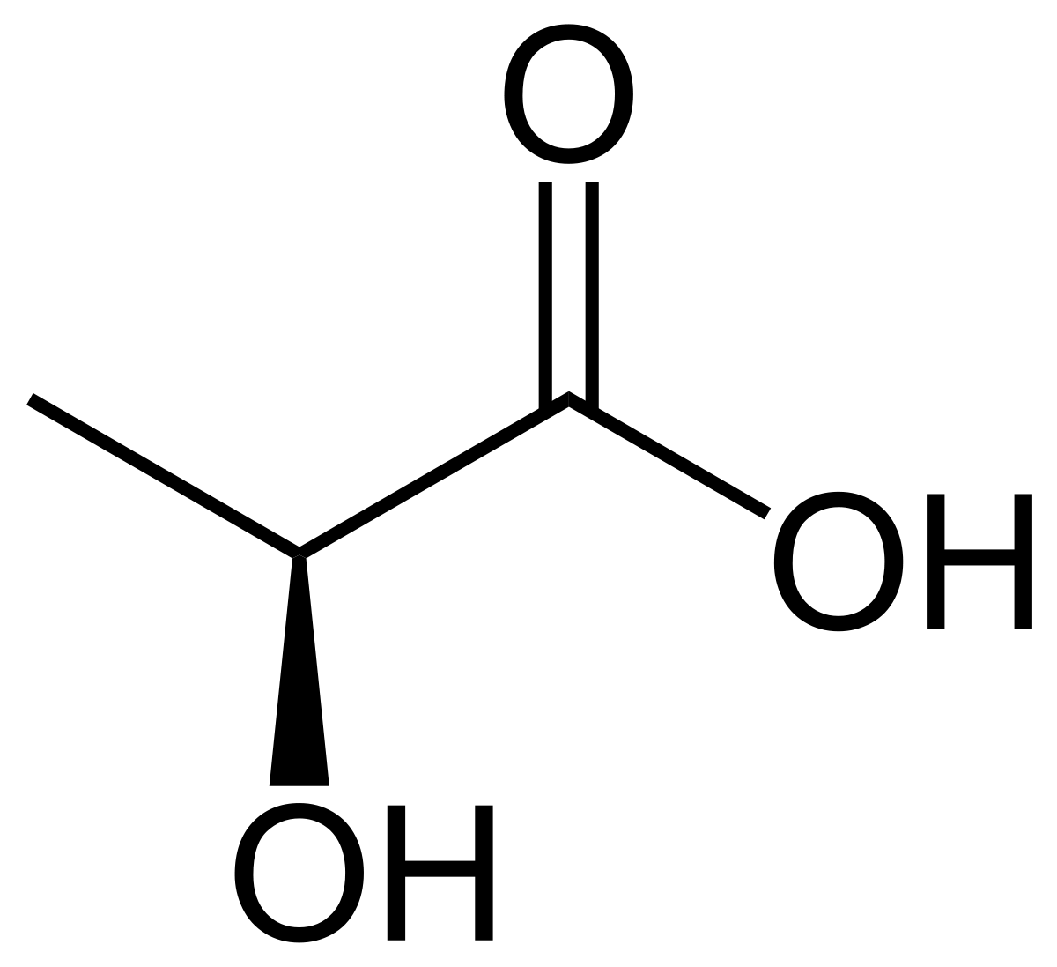
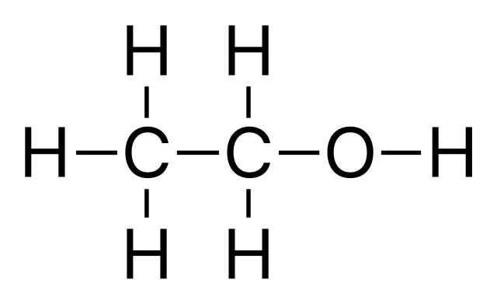
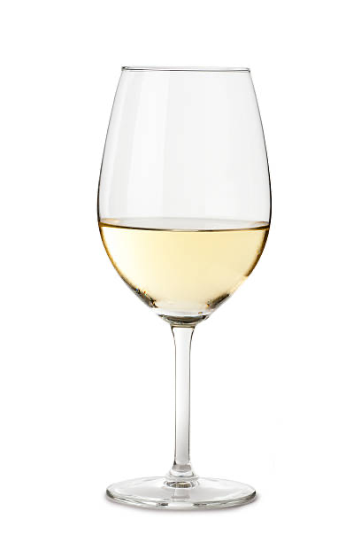
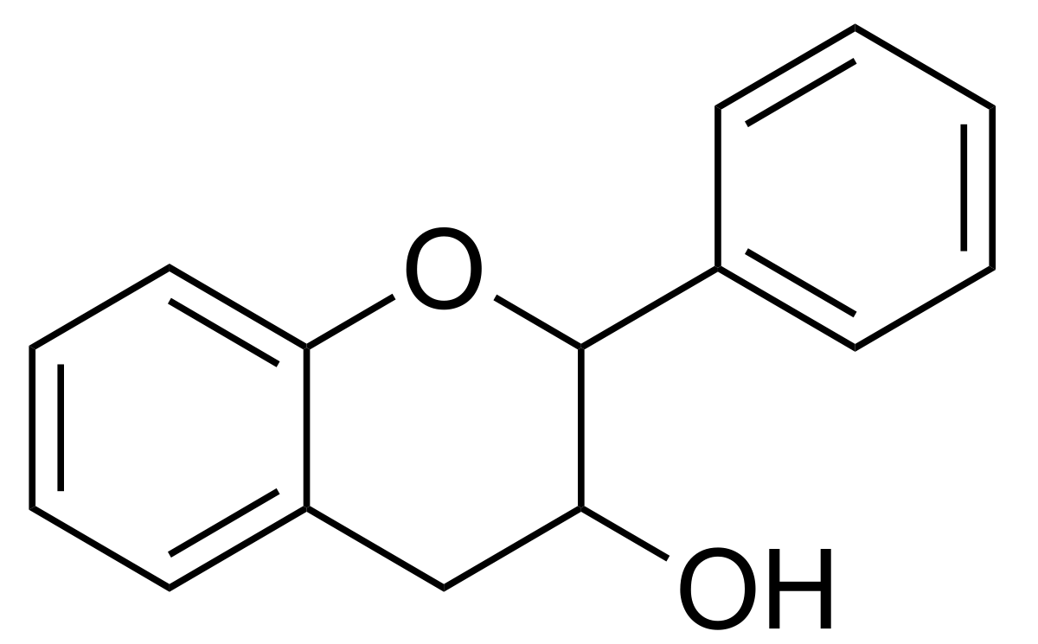
Problem Statement
Can the chemical properties of wine predict its quality?

Slide 3
Key Questions
What variables contribute the most to the quality of a white wine?
Why might these variables contribute to the quality and in what way (positive or negative)?
Can these variables be used to predict the quality of future wine datasets?

Slide 4
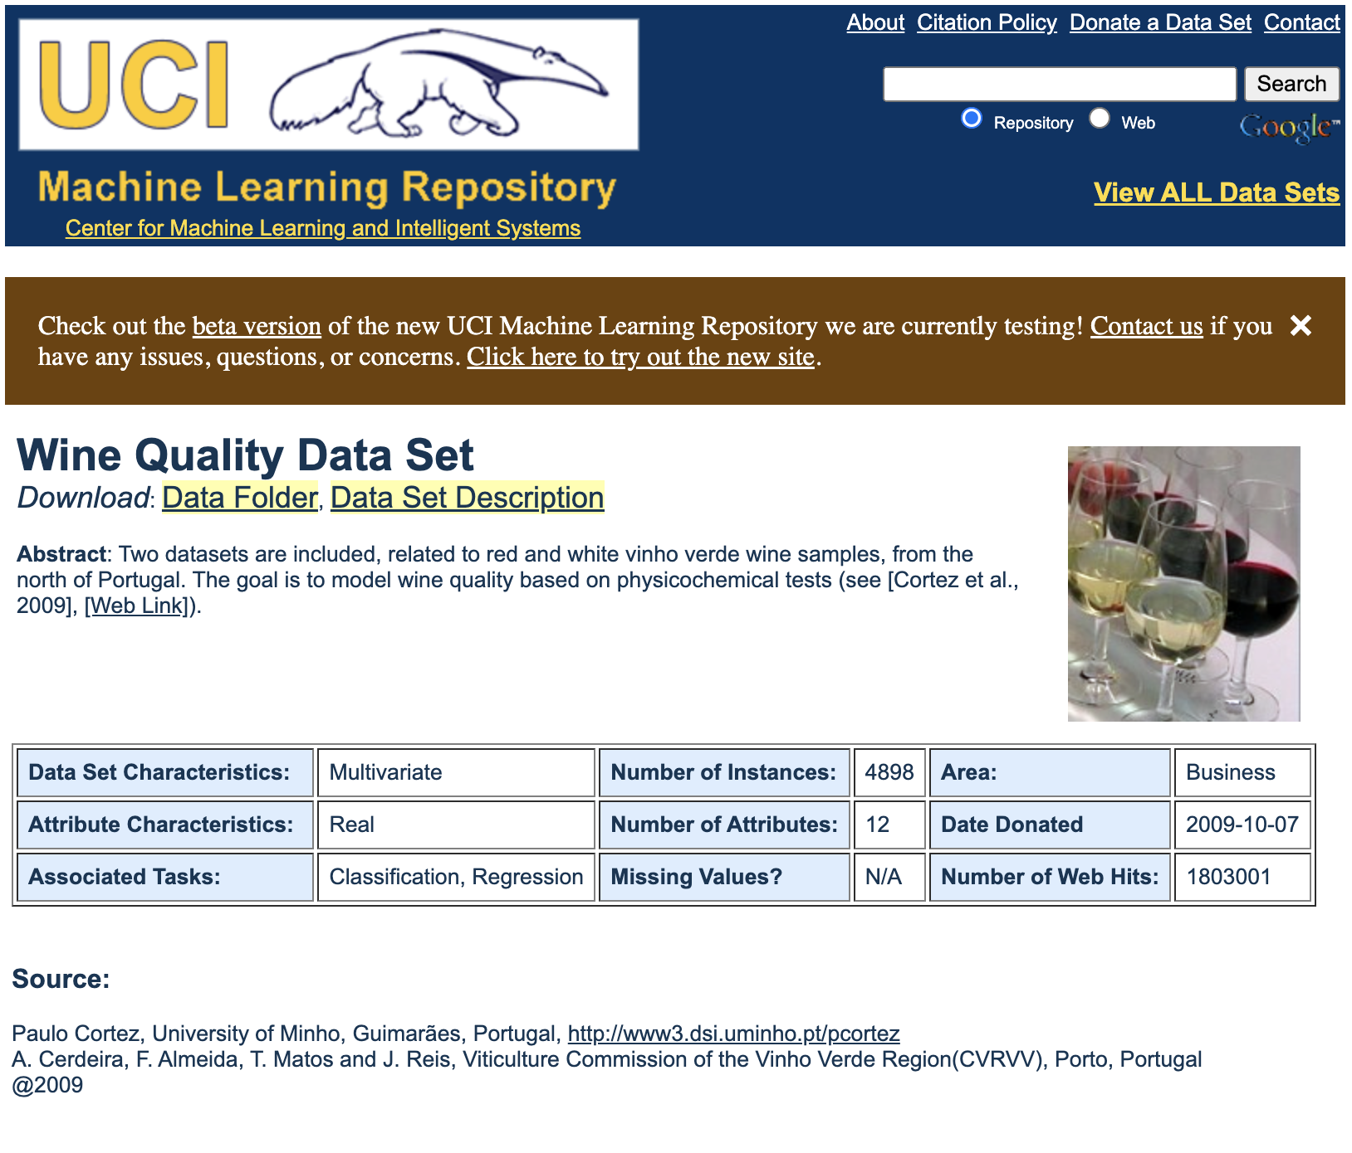
Data Sources
.csv file from UCI Machine Learning Repository
Dataset was created using red and white wine samples
White wine variants of the Portuguese "Vinho Verde" wine
4,898 Observation & 12 Variables
0 missing attribute values
All variables contain doubles/integers
https://archive.ics.uci.edu/ml/datasets/Wine+Quality

Slide 5
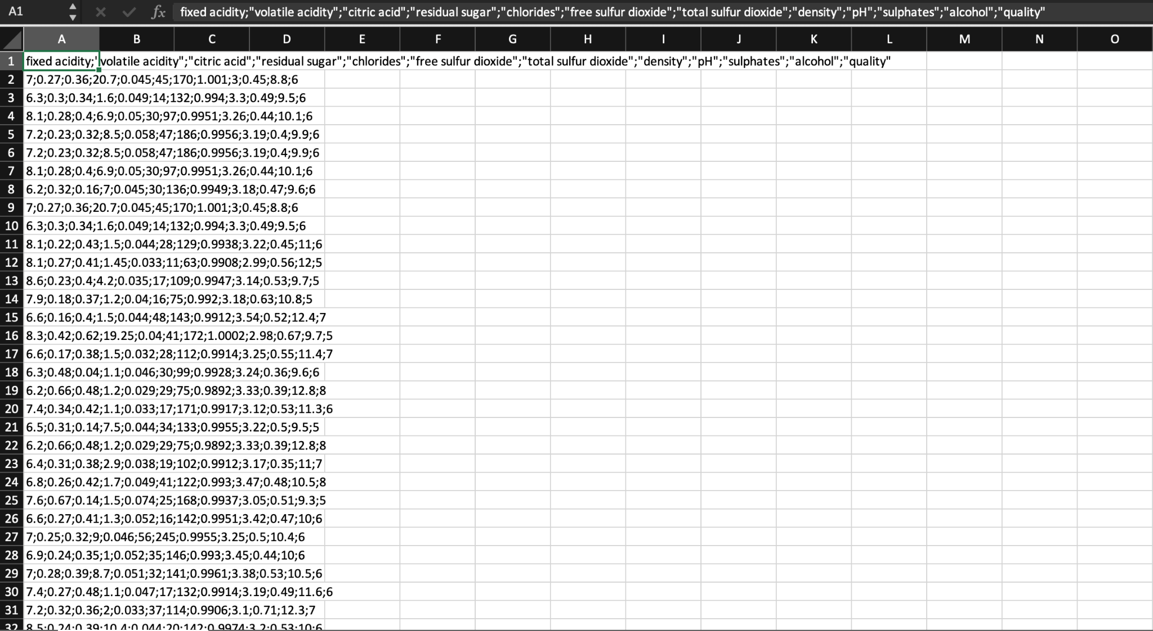
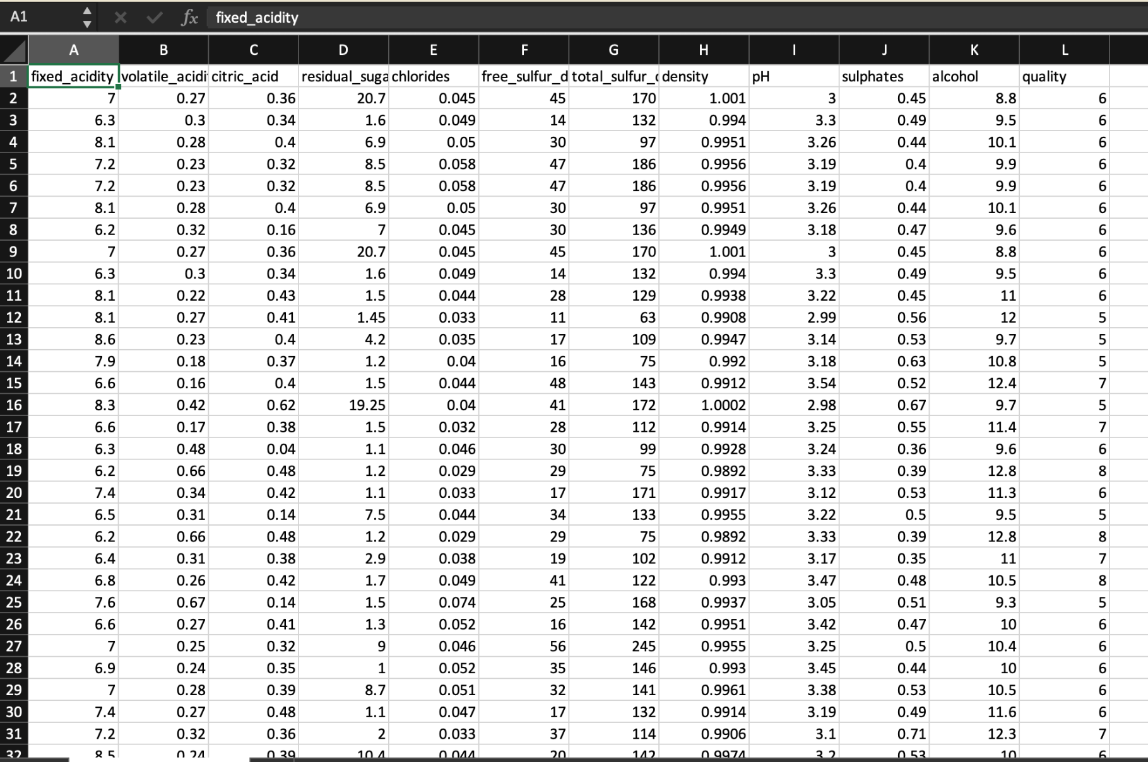
Data Organization/Wrangling
Original .csv file
Clean .csv file

Slide 6
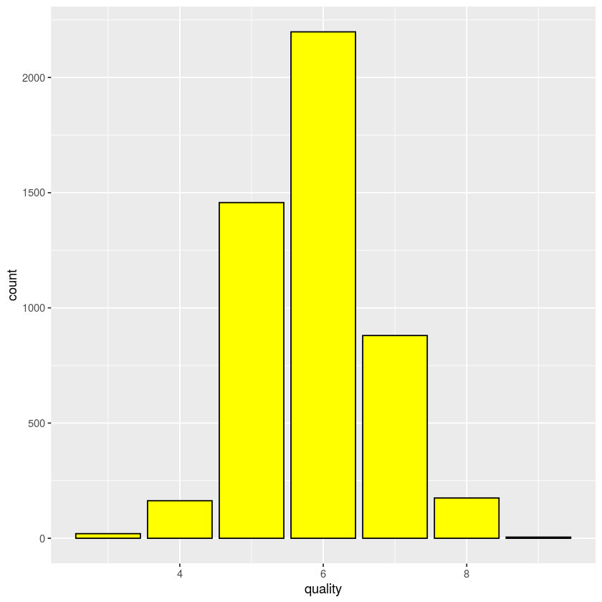
Data Exploratoration: Response Variable
Quality: An integer score between 1-10 assigned to a wine.
Quality can be subjective and is usually determined by four key indicators
Complexity
Balance
Typicity
Finish
In our dataset, the distribution of quality ranges from 3 (worst) to 9 (best) and is relatively normal

Slide 7
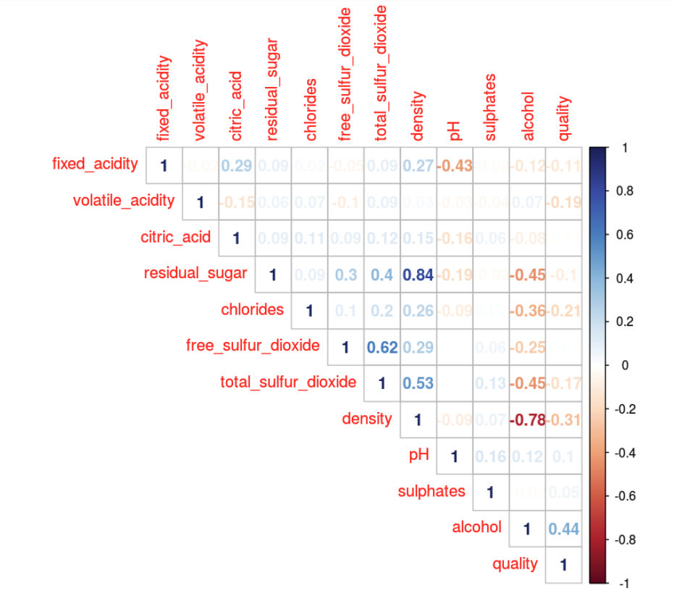
Data Exploratoration: Explanatory Variables
We created a correlation plot to view the relationships between all variables and select the explanatory variables for our models
Found the highest correlations with Quality to be
Alcohol
Chlorides
Volatile Acidity
Density
Due to Density’s strong negative correlation with Alcohol, it was dropped from consideration

Slide 8
Data Exploratoration: Explanatory Variables
Alcohol: The percentage of alcohol present in the wine. Wines with higher alcohol percentage tend to be more favorable.
Min: 8%
Median: 10.4%
Max: 14.2%
Chlorides: The concentration of chlorides in the wine. Wines with higher concentrations of chlorides tend to be more salty.
Min: 0.009 g/L
Median: 0.043 g/L
Max: 0.346 g/L
Volatile Acidity: The presence of acetic acid in the wine. High concentrations of acetic acid can contribute to a vinegar-like aroma.
Min: 0.08 g/L
Median: 0.26 g/L
Max: 1.10 g/L

Slide 9
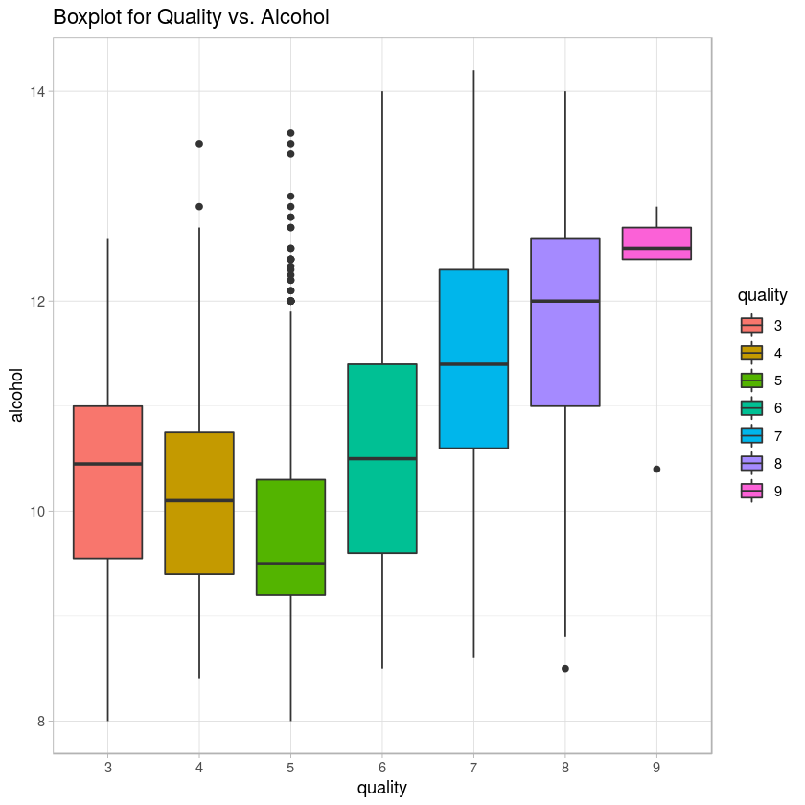
Data Visuals (Alcohol)
Distribution between wine quality and alcohol level
Wine quality 9 has the highest average alcohol level while wine quality 5 has the lowest average alcohol level
Wine quality 5 has the most outliers compared to all the other wine quality categories
Can assume that the higher the alcohol level, the higher the wine quality

Slide 10
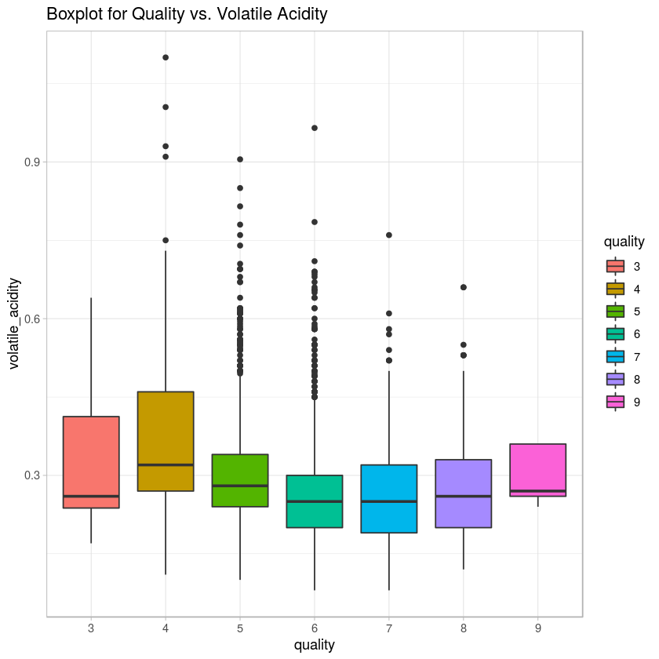
Data Visuals (Volatile Acid)
Boxplot to show distributions between wine quality and volatile acidity
Wine quality 5 & 6 shows more outliers compared to the other wine quality categories
Volatile acidity ranges more closely within the different wine quality ranges

Slide 11
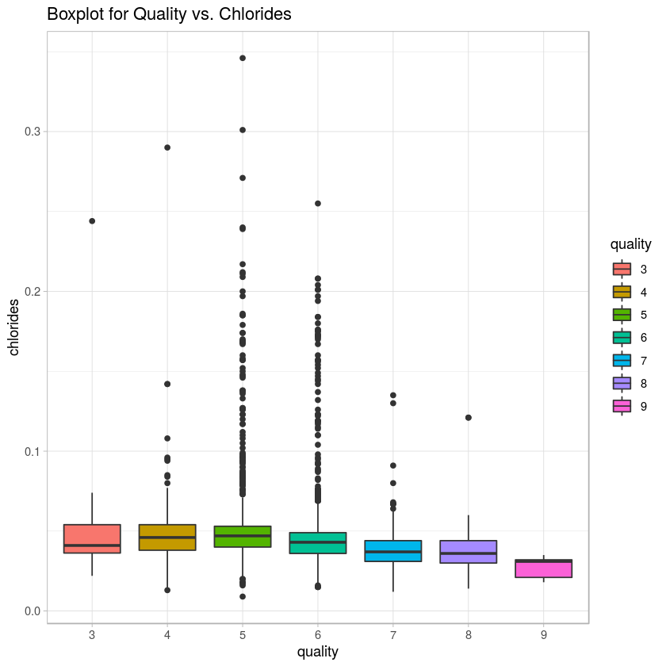
Data Visuals (Chlorides)
Boxplot to show distribution between wine quality and chloride levels
Wine quality 5 & 6 shows more outliers compared to the other wine quality categories
Higher wine quality seems to show lower levels of chlorides

Slide 12
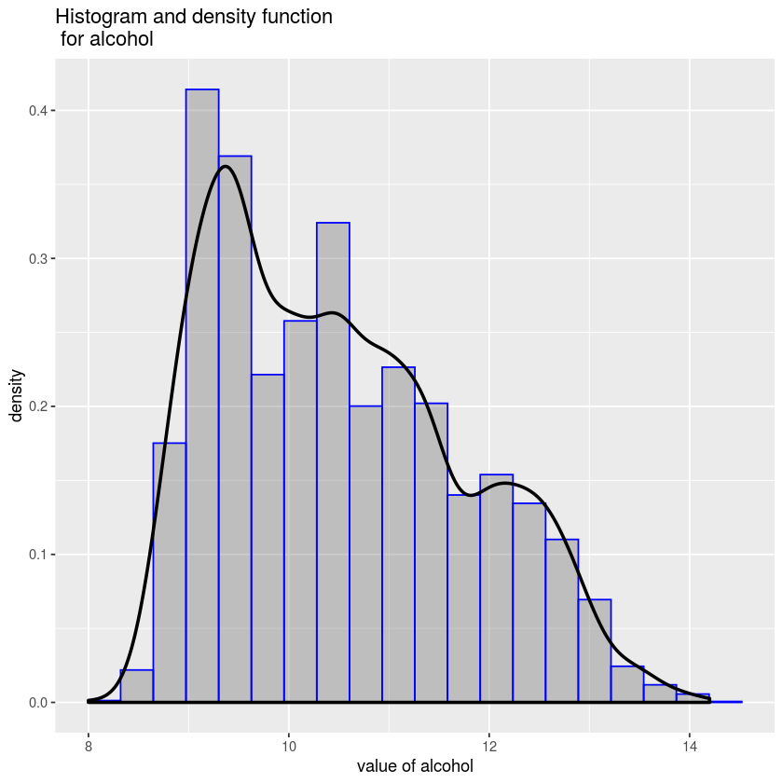
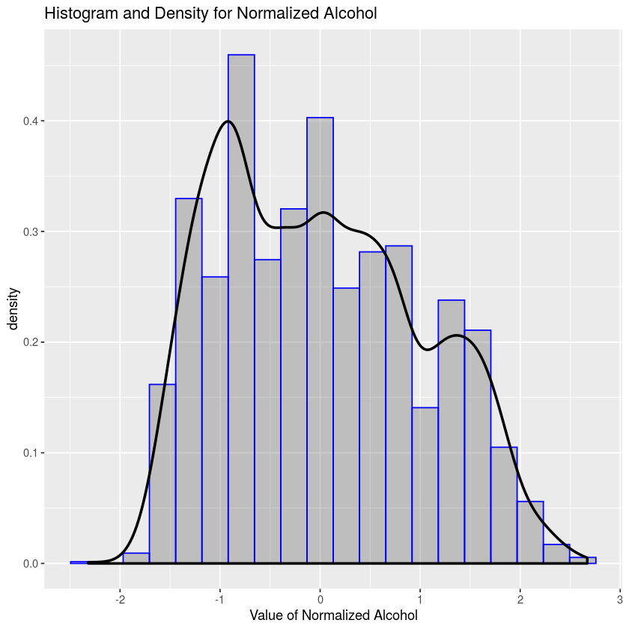
Data Normalization (Alcohol)
Notes:
Notes: using log and user-defined normalize function

Slide 13
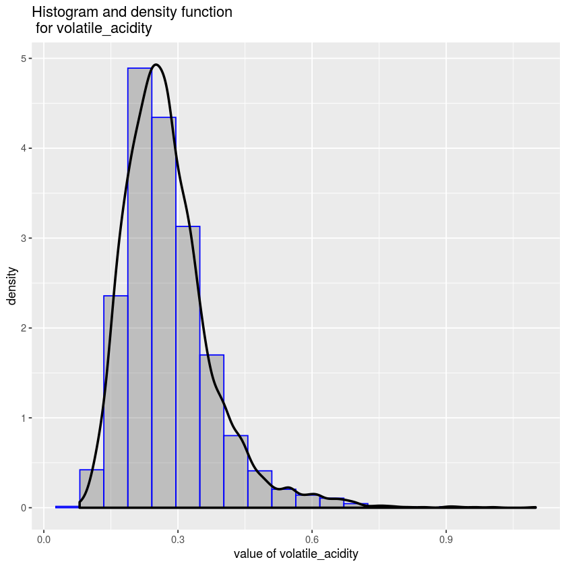
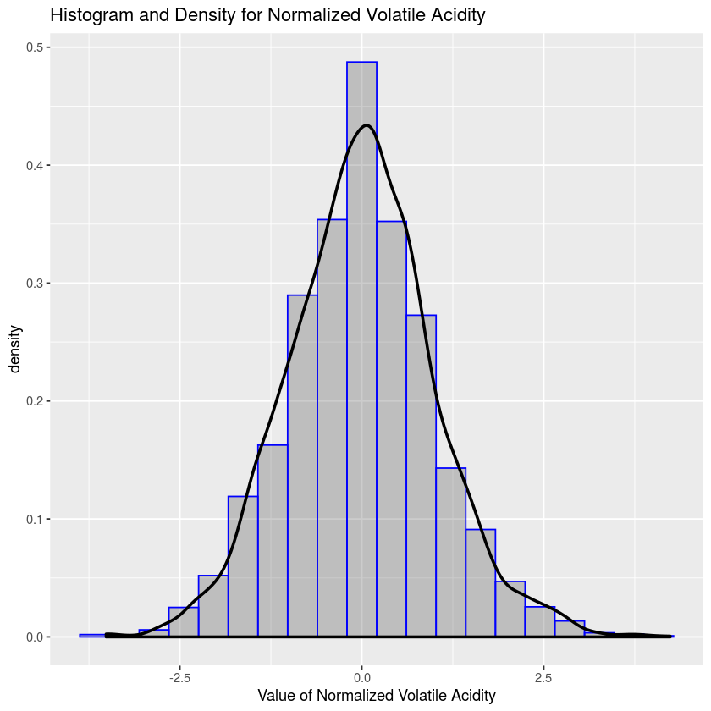
Data Normalization (Volatile Acidity)

Slide 14
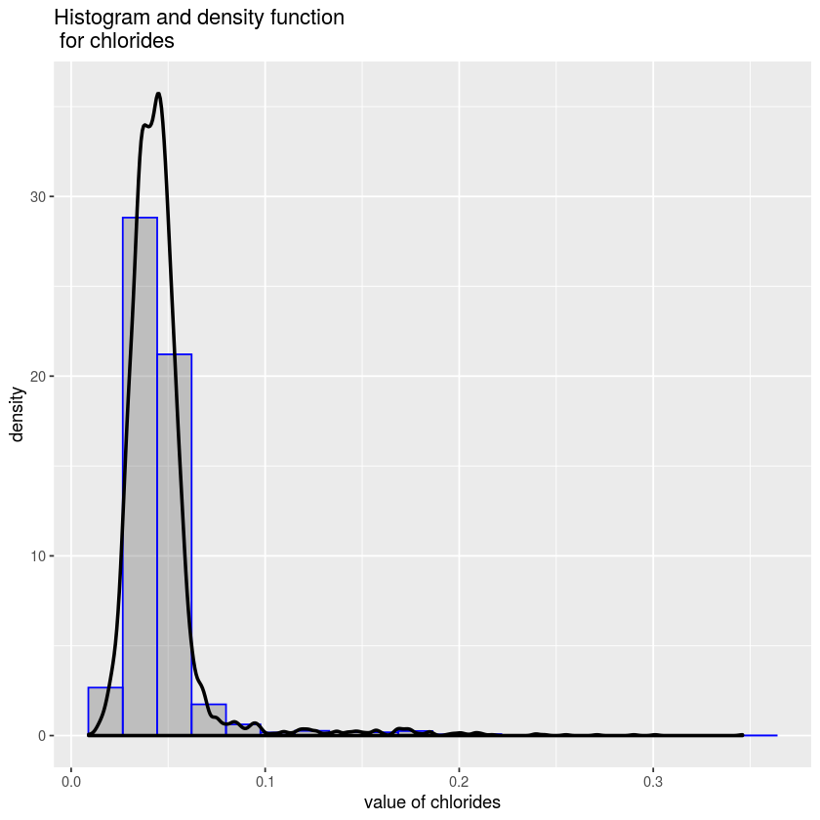
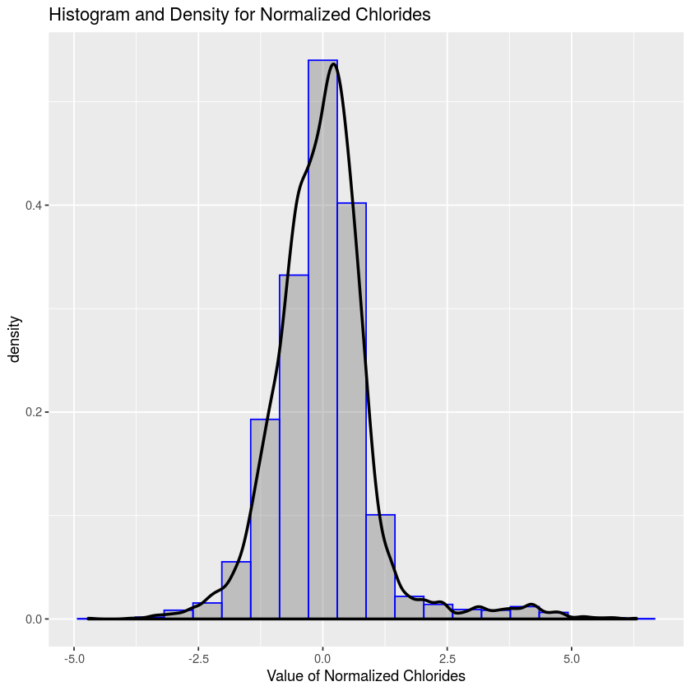
Data Normalization (Chlorides)

Slide 15
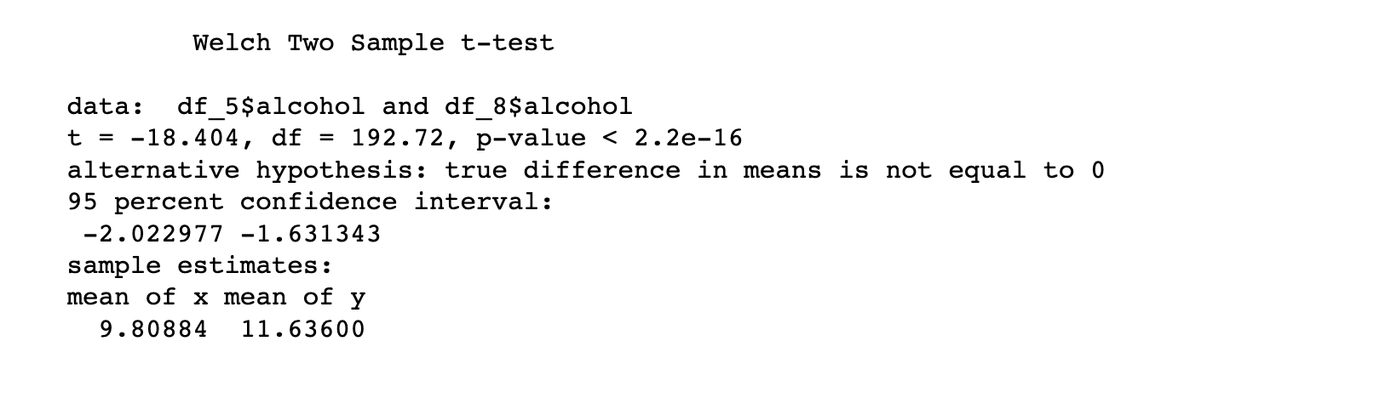
Hypothesis Testing
Performed one sided and two sided t-test models for wine qualities 5 & 8 at 95% confidence level
P-Value: 2.2e-16
Confidence interval: -2.022977 ~ -1.631343
Reject null hypothesis

Slide 16
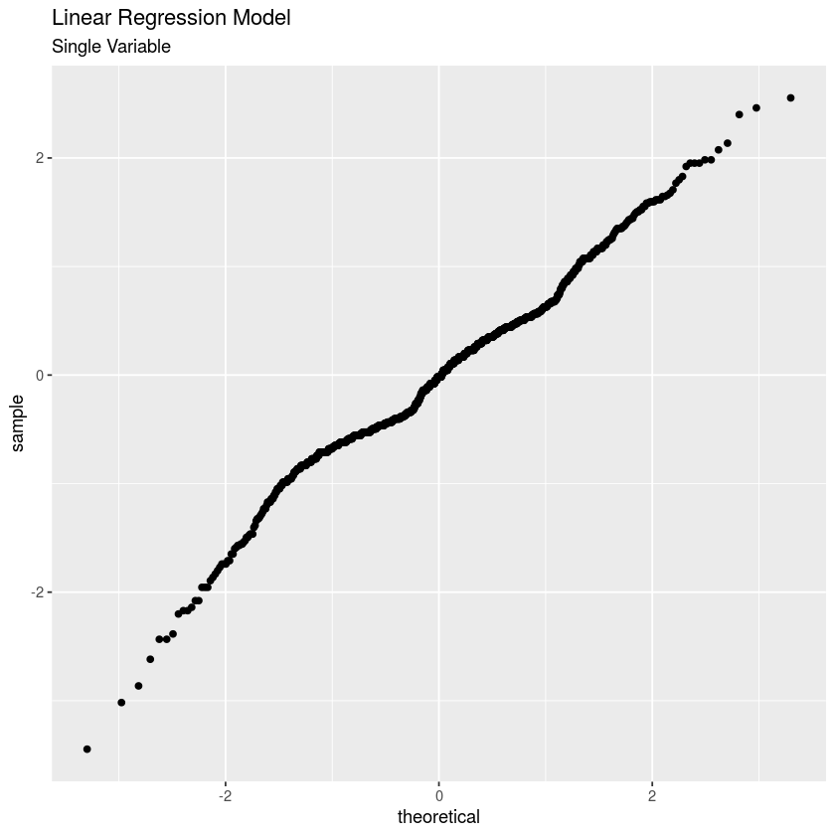
Prediction Models (Single Variable)
Q-Q plot for wine quality and alcohol level
Predicting variable
Alcohol (positive effect)
Split original dataset into train (70%) and test (30%) sets
Alcohol was statistically significant
Determined alcohol is a good predictor for wine quality

Slide 17
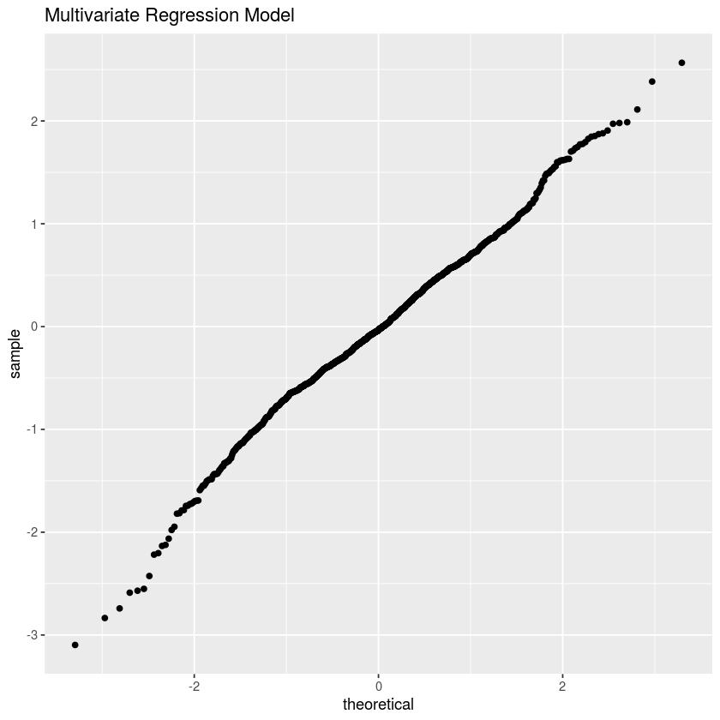
Prediction Models (Multivariate)
Predicting variables
Alcohol (positive effect)
Volatile Acidity (negative effect)
Chlorides (negative effect)
Split original dataset into train (70%) and test (30%) sets
All variables were statistically significant
Q-Q plot for wine quality and alcohol level
Determined, when used together, alcohol, volatile acidity, and chlorides are good predictors of wine quality

